Slide 1
New Features

Slide 2
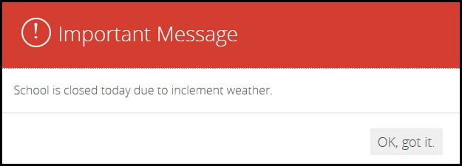
New Features – On Screen Alerts
On-Screen Alerts are highly visible messages that notify you of situations that arise quickly or at inconvenient times
Weather Emergencies, Lockdown Situations
Notes:
We do not recommend using for non-emergency news items – if it is overused people will eventually begin to ignore it. Close it without reading….

Slide 3
New Features – On Screen Alerts
When alert messages are posted by your district, you’ll see them when you navigate to the website
Once you read the messages, click OK, got it and the dialog collapses into an Exclamation icon
Click the Exclamation icon to redisplay the important Message window at any time
EXAMPLE/DEMO
Click to redisplay message

Slide 4
Enhanced Broadcast E-Alert Tool
Broadcast E-Alerts allow you to mass communicate with users
You use Broadcast E-Alerts to relay important information such as school closings, events and early dismissals
The Broadcast E-Alert types include Email, Text Message, Push Notification, Announcement, Facebook and Twitter

Slide 5
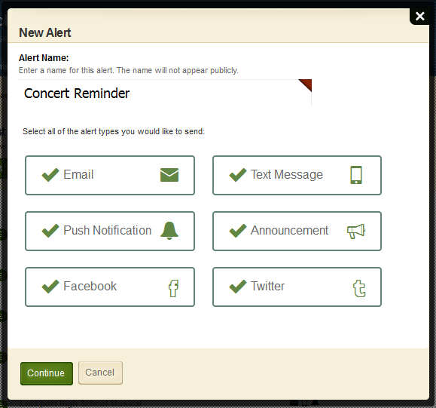
Enhanced Broadcast E-Alert Tool

Slide 6
Enhanced Broadcast E-Alert Tool
To use the Social Media options, you must first allow access and connect to Facebook and Twitter
Configure/System Settings/Alerts tab
Site Workspace/Settings/Advanced tab
DEMO

Slide 7
New Features – Google Folder App
The Google Folder App allows you to share your Google Folders (Google Drive) on your Blackboard website
Files can be displayed as a grid or list
http://lakepark.wnyric.org/Page/3236
The Google Folder App is the first Blackboard app that can be updated independent of a release
http://help.schoolwires.com/Page/1949 - download app here
To allow you to take advantage of this and other apps in the future, we have added the ability for Site Administrators to import and update custom apps as well as manage the sharing rights on them

Slide 8
New Features - Google Calendar Sync
Google Calendar Integration allows you to sync a Google Calendar with the website Calendar App
The Sync One Way option will import events from a Google Calendar into a Calendar App
These events display as locked and must be edited in the Google Calendar
The Sync Both Ways option will import events from a Google Calendar into a Calendar App and export events from a Calendar App into a Google Calendar
These events can be edited in a Calendar App or Google Calendar
You can integrate one Google Calendar per Calendar App.
To set up the sync, click on the Options button for the Calendar App
Canaseraga CSD Calendar
Notes:
The Calendar Sync feature has improved since it first came out. There are however, limitations that should be reviewed before using this tool. Refer to Working with Google Calendar Integration Guide – pg 17 (under Google Calendar limitations heading) (when searching for this, just type Google Calendar). Also, you must plan on repairing or refreshing the Calendar App frequently – even thought the guide says it only needs to be done periodically. We spoke with support team and they said to do it every time you update.

Slide 9
New Features - Google Calendar Sync
You will need to repair or refresh your Google Calendar Integration frequently:
Click Refresh in your Calendar App
The Refresh button displays automatically on the calendar in Site Manager when the calendars need to be synced
You can also sync the calendars in App Options by clicking Repair

Slide 10
New Features – Premium Video App
The Premium Video App (PVA) is a simple way to add video to a web page and ensure it can be viewed on any device
Video creators may use any file or format to post; viewers don’t have to install plug-ins to watch
Share district and school special events such as graduation ceremonies, board meetings, athletic events, morning announcements, flipped learning, superintendent/principal messages, and professional development training

Slide 11
New Features – Premium Video App
Salamanca – Mrs. Brenda Green
http://www.salamancany.org/Page/2573
Advantages of the PVA
Save on file storage
Easy to use - upload as is, no resizing, compression, or conversion required (2 GB max)
Viewers can play the video without having to download/install various software
Compatible with most devices and browsers

Slide 12
New Features – Premium Video App
Cost: $175 per site/subsite
Hosted at MyVRSpot
40 GB per site
Purchase additional storage if needed
Sold in 10 GB increments

Slide 13
New Features – Table App
The Table App was designed to simplify the experience of creating and editing tables
ADA compliant
Table will resize automatically to fit viewer screen sizes
Great way to separate your table from other content

Slide 14
New Features – Table App
Example – Lockport – Important Contacts
Demo of the Table App
Add the Table App to a page
Set the basic table options
Enter data
Review formatting options

Slide 15
New Features–Staff Directory Improvements
Enhancements to the Staff Directory App, including fields for picture, title and website
Example – Fredonia Staff Directory
New Sample Import Files
Sample CSV File for Importing Half-Hourly Parent Teacher Conference Events
Sample CSV File for Importing Hourly Parent Teacher Conference Events
Demo – How Do I tab – enter Sample and search
Notes:
Search all staff – go to page 5.

